Slide 1


Slide 2
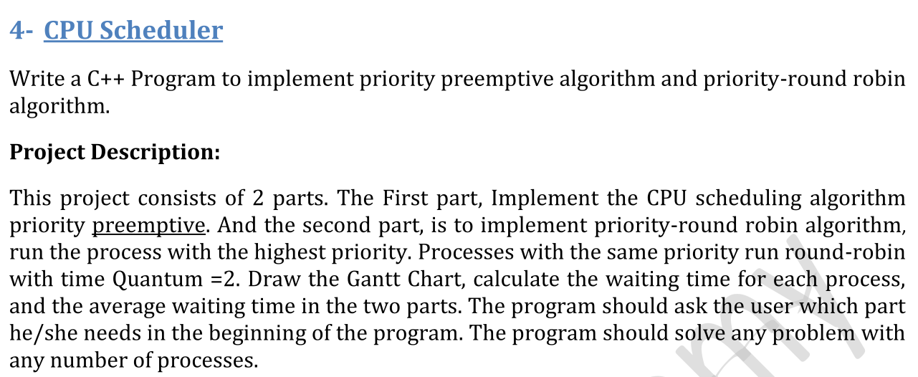

Slide 3
I decided to write the code in assembly 8086
Instead of c++

